Slide 1
Semantic Segmentation
Project on the CamVid dataset

Slide 2
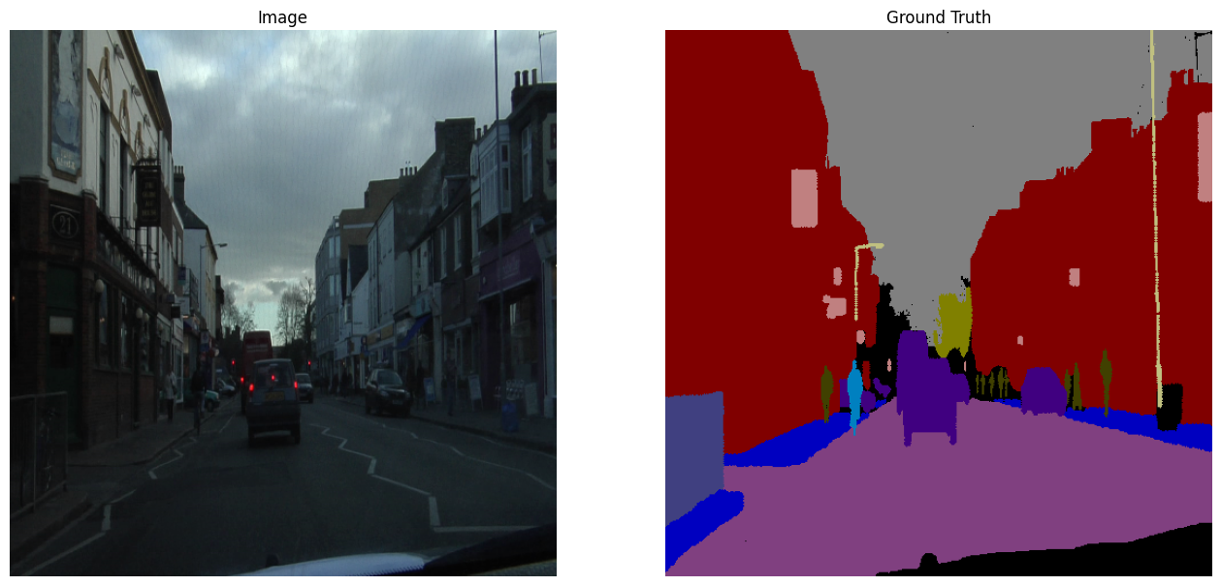
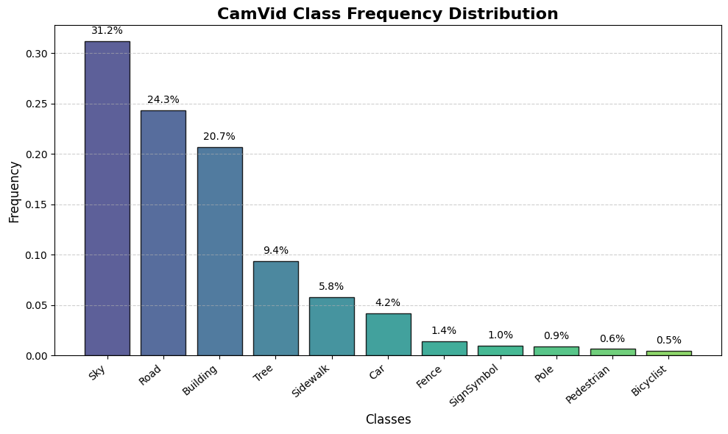
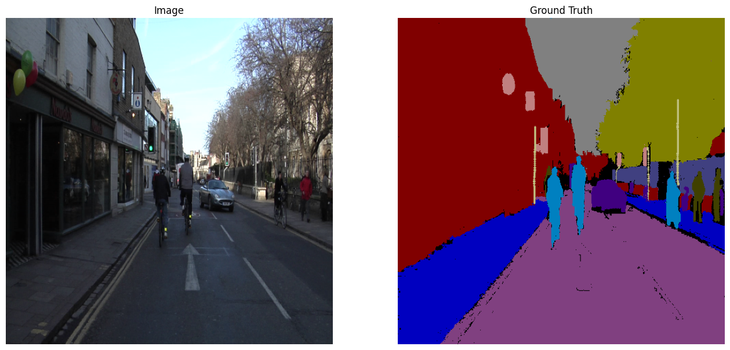
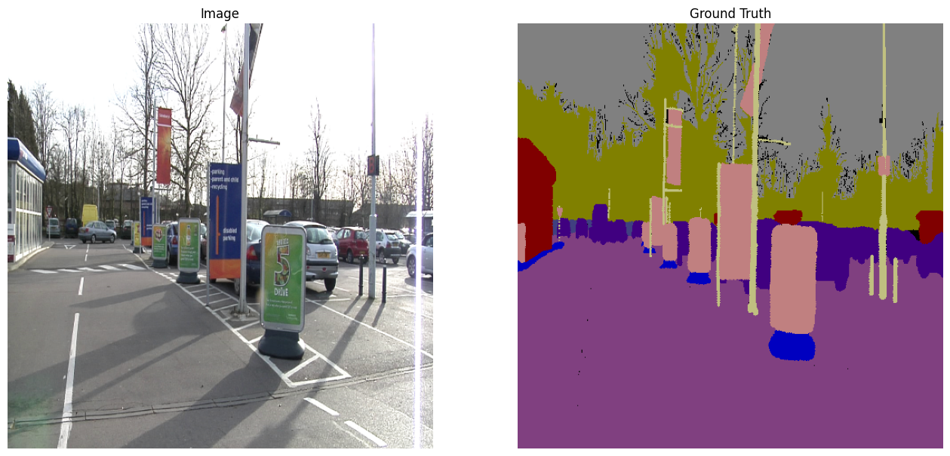
CamVid Dataset
700 images:
500 train
100 validation
100 test
11 imbalanced semantic classes
Applied transformations:
Resizing
Random rotation
Perspective distortion
Normalization (mean and std from ImageNet)
Horizontal flip

Slide 3
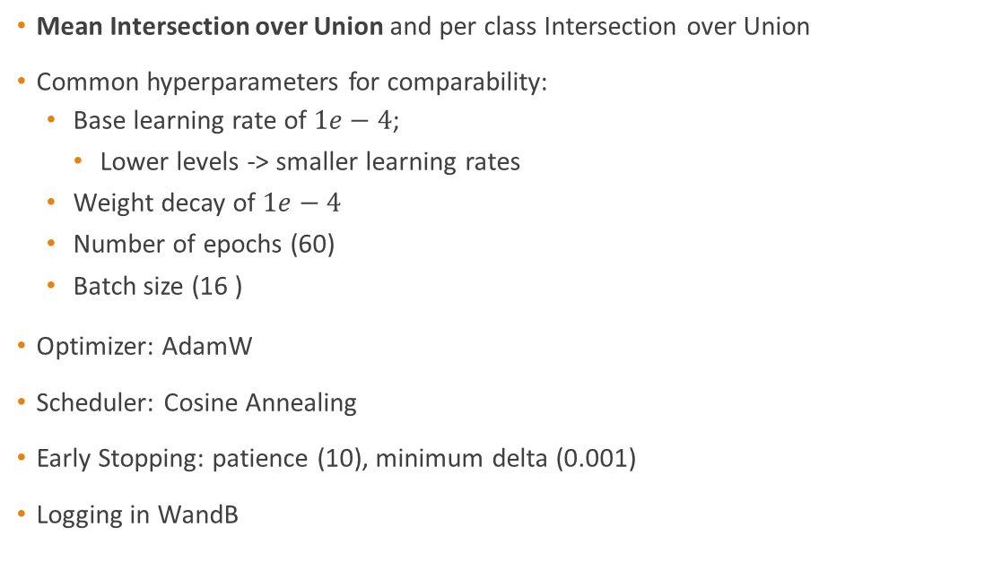
Evaluation metric and train procedure
Mean Intersection over Union and per class Intersection over Union
Common hyperparameters for comparability:
Base learning rate of $1e−4$;
Lower levels -> smaller learning rates
Weight decay of $1e−4$
Number of epochs (60)
Batch size (16 )
Optimizer: AdamW
Scheduler: Cosine Annealing
Early Stopping: patience (10), minimum delta (0.001)
Logging in WandB

Slide 4
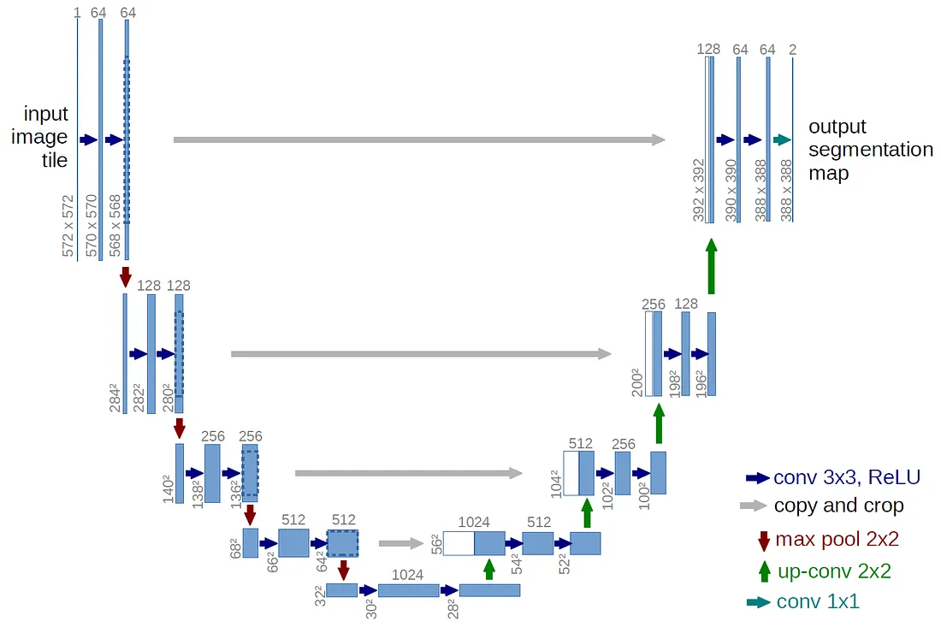
U-Net
Baseline model
Encoder-Decoder architecture
Skip connections
Transposed convolutions
ResNet backbones
U-Net backbone | Parameters (M) | Giga flops
Baseline model | 31.04 | 219.14
ResNet-34 | 38.35 | 44.30
ResNet-50 | 71.89 | 152.07
ResNet-101 | 90.88 | 171.57

Slide 5
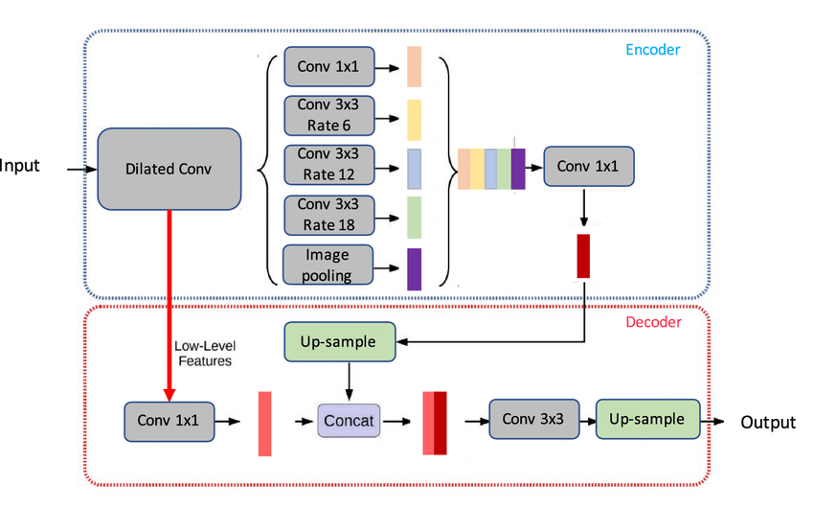
DeepLab V3+
Dilated convolutions
Atrous Spatial Pyramid Pooling module
Decoder to refine segmentation boundaries
Backbone | Parameters (M) | Giga flops
ResNet-50 | 40.35 | 70.35
ResNet-101 | 59.34 | 89.75

Slide 6
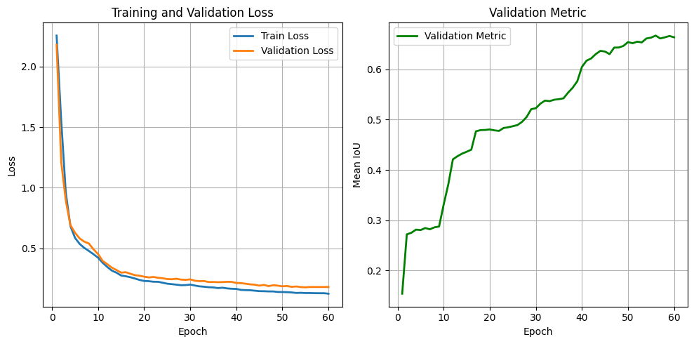
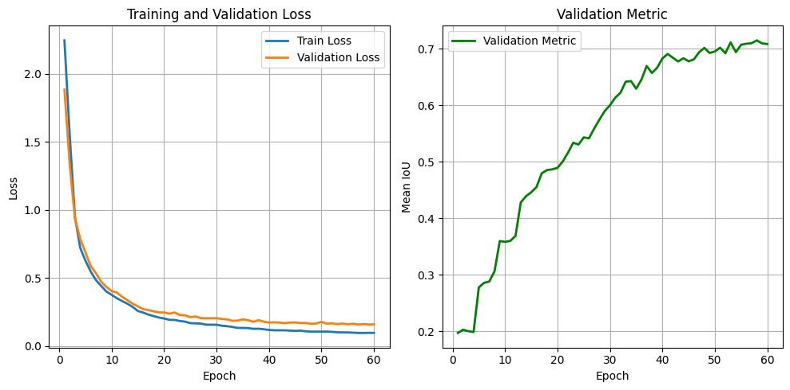
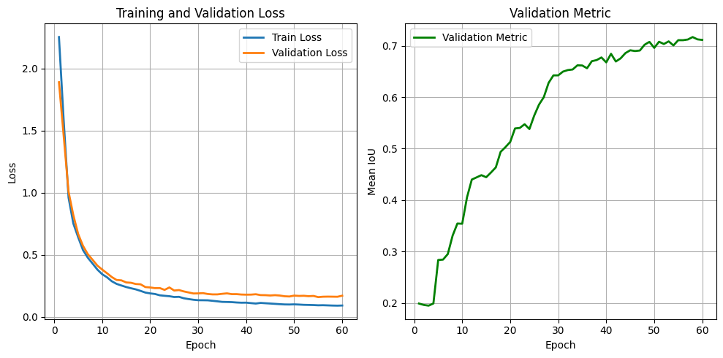
U-Net backbones comparison
Pre-trained backbones
Model | mIoU | Sky | Building | Pole | Road | Sidewalk | Tree | Sign | Fence | Car | Pedestrian | Bicyclist
Baseline | 0.649 | 0.937 | 0.844 | 0.1 | 0.95 | 0.797 | 0.8 | 0.4 | 0.617 | 0.8 | 0.35 | 0.5
ResNet-34 | 0.713 | 0.938 | 0.893 | 0.166 | 0.966 | 0.84 | 0.84 | 0.54 | 0.652 | 0.87 | 0.46 | 0.67
ResNet-50 | 0.758 | 0.94 | 0.9 | 0.299 | 0.968 | 0.856 | 0.84 | 0.63 | 0.74 | 0.89 | 0.54 | 0.7
ResNet-101 | 0.756 | 0.943 | 0.9 | 0.26 | 0.973 | 0.86 | 0.84 | 0.61 | 0.697 | 0.89 | 0.57 | 0.764
ResNet-34
ResNet-50
ResNet-101

Slide 7
DeepLab backbones comparison
Increasing model capacity improves the results
Model | mIoU | Sky | Building | Pole | Road | Sidewalk | Tree | Sign | Fence | Car | Pedestrian | Bicyclist
Best U-Net | 0.758 | 0.94 | 0.9 | 0.299 | 0.968 | 0.856 | 0.84 | 0.63 | 0.74 | 0.89 | 0.54 | 0.7
ResNet-50 | 0.731 | 0.936 | 0.89 | 0.19 | 0.961 | 0.825 | 0.82 | 0.54 | 0.72 | 0.868 | 0.54 | 0.72
ResNet-101 | 0.743 | 0.934 | 0.895 | 0.198 | 0.963 | 0.836 | 0.83 | 0.57 | 0.725 | 0.878 | 0.572 | 0.762
Pytorch’s-101 | 0.752 | 0.936 | 0.897 | 0.21 | 0.97 | 0.865 | 0.83 | 0.63 | 0.737 | 0.87 | 0.54 | 0.759

Slide 8
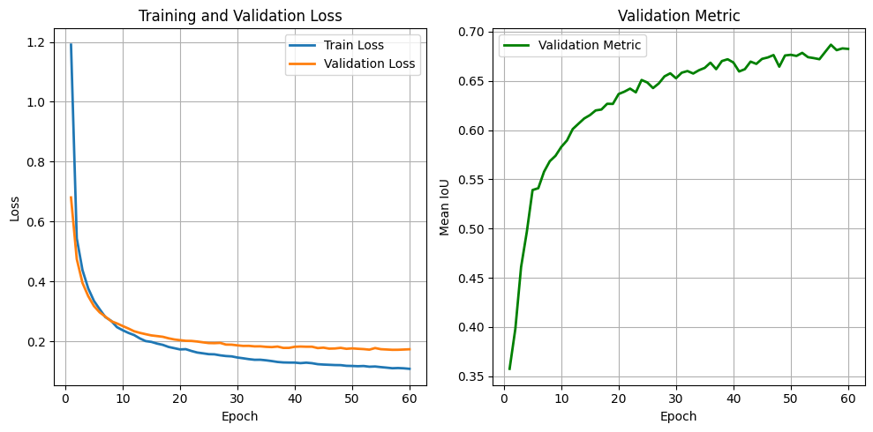
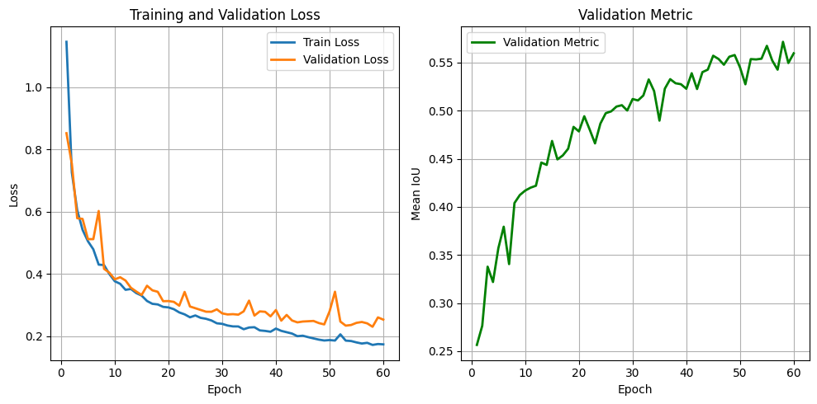
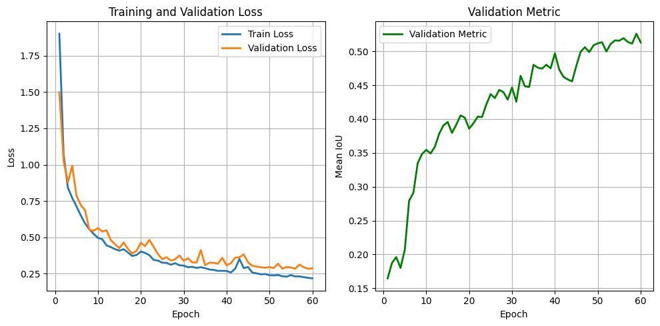
Pretrained vs. Trained from scratch
Pretrained backbones have smoother training
Better performance with pretrained backbones
Model | Pretrained | mIoU
U-Net ResNet-34 | No | 0.5423
U-Net ResNet-34 | Yes | 0.7134
DeepLab V3+ (50) | No | 0.5941
DeepLab V3+ (50) | Yes | 0.7316
DeepLab V3+
U-Net
Pretrained
From scratch

Slide 9
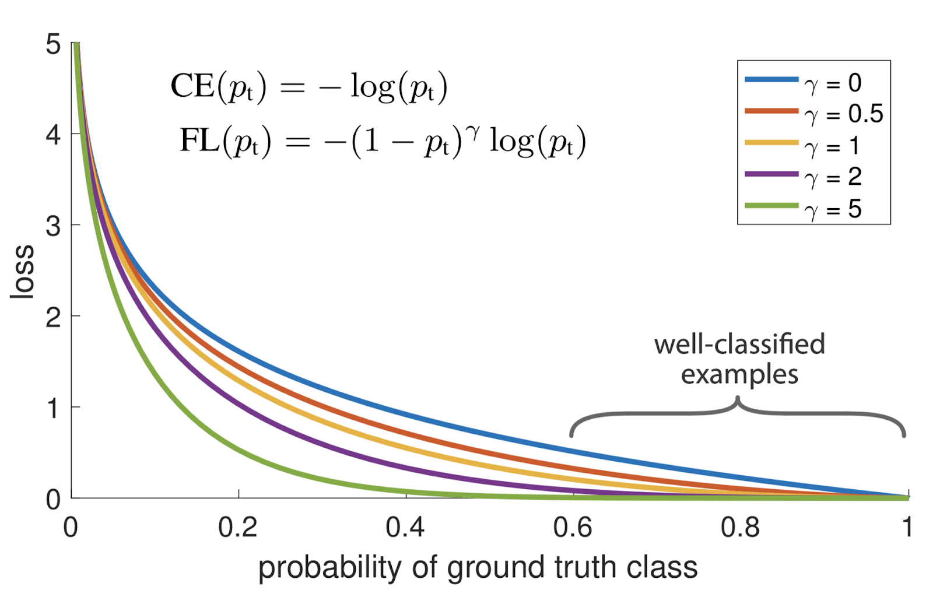
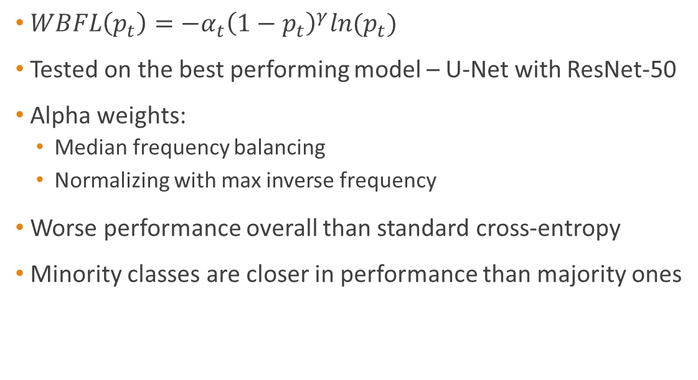
Focal loss
$WBFL\left(p_{t}\right)=−α_{t}{\left(1−p_{t}\right)}^{γ}ln{(p}_{t})$
Tested on the best performing model – U-Net with ResNet-50
Alpha weights:
Median frequency balancing
Normalizing with max inverse frequency
Worse performance overall than standard cross-entropy
Minority classes are closer in performance than majority ones
Loss function | mIoU | Sky | Building | Rode | Pole | Pedestrian | Bicyclist
Cross entropy | 0.757 | 0.94 | 0.9 | 0.968 | 0.29 | 0.546 | 0.703
Median frequency | 0.704 | 0.908 | 0.84 | 0.925 | 0.282 | 0.551 | 0.701
Max frequency | 0.705 | 0.910 | 0.84 | 0.926 | 0.24 | 0.523 | 0.712

Slide 10
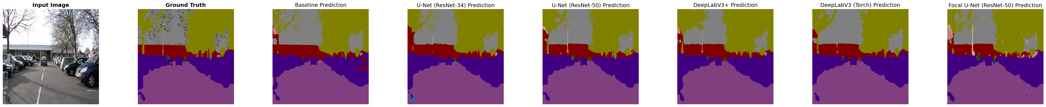
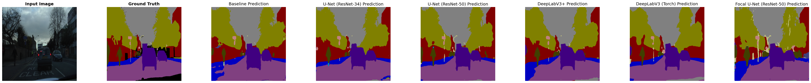
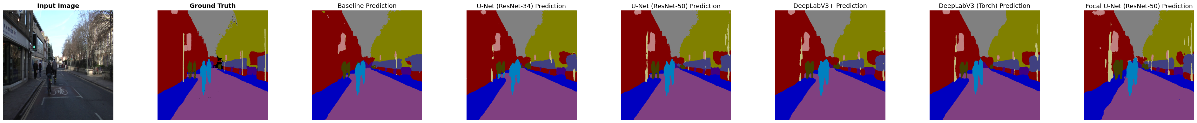
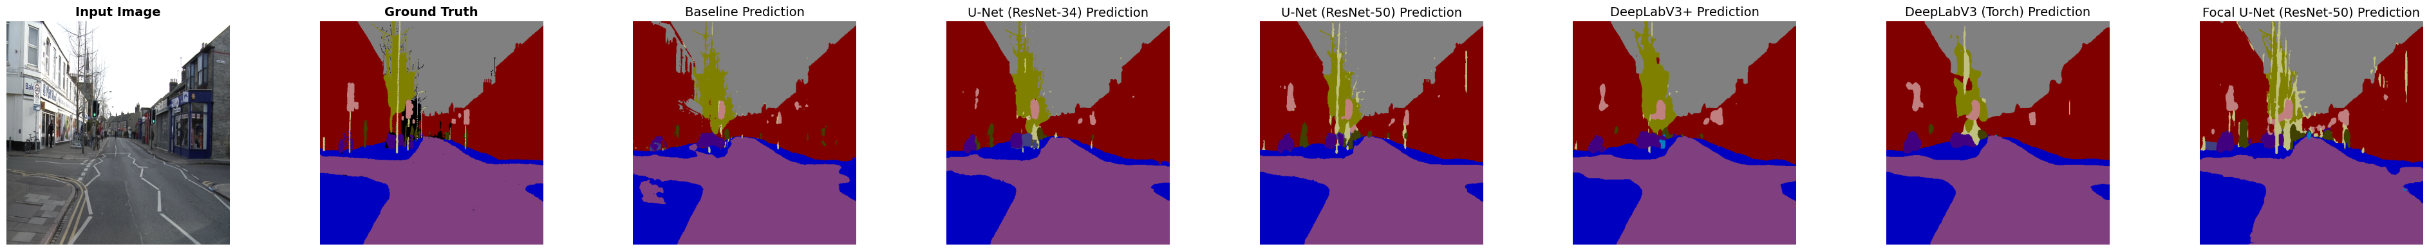
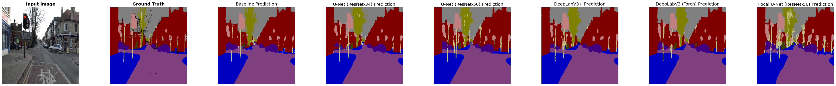

Slide 11
Conclusions
Best model: U-Net with ResNet-50 backbone
Pretrained backbones boost performance
Focal loss didn’t obtain the desired results
Could be interesting to try some transformer based approach, but the small amount of data could be a limit

